Slide 1
Computer Network
Chapter-1

Slide 2
Computer Network
A network is a set of devices (often referred to as nodes) connected by communication links. A node can be a computer, printer, or any other device capable of sending and/or receiving data generated by other nodes on the network.
“Computer network’’ to mean a collection of autonomous computers interconnected by a single technology.
Two computers are said to be interconnected if they are able to exchange information.
These devices communicate using:
Wired connections (Ethernet cables)
Wireless connections (Wi-Fi, Bluetooth, cellular networks)
A network allows devices to exchange data quickly and reliably based on standard rules called network protocols (like TCP/IP).

Slide 3
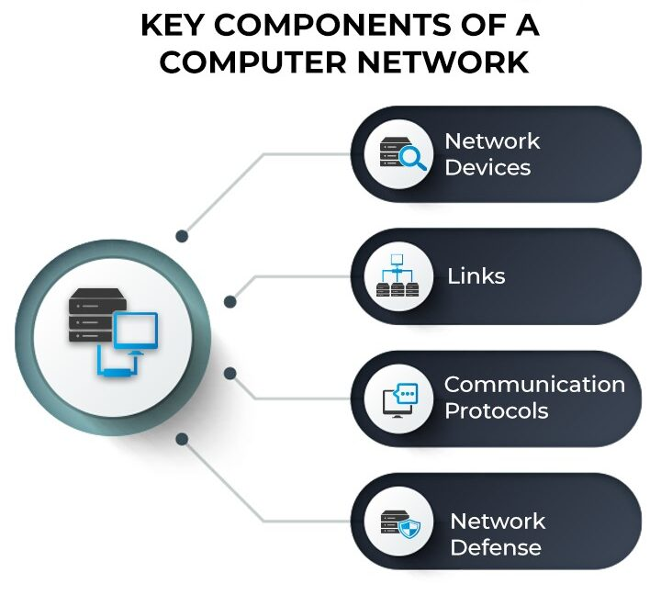

Slide 4
Importance of Computer Networks
Faster and Easier Communication
Computer networks make communication instant and cost-effective. They support:
Email, Messaging, Voice calls (VoIP), Video meetings, File sharing, etc.
Whether it’s a small team or a global company, networks help people connect without delays.
Sharing of Resources
Networks allow multiple users to share expensive devices and services, such as:
Printers, Scanners, Storage servers, Internet connection, Special software (licensed for network use)
This removes the need to buy separate devices for each user and reduces operating costs.
Centralized Data Storage and Management
Instead of storing files separately on each computer, networks allow organizations to keep data in central servers or cloud systems. This brings several advantages:
Consistent data for everyone, Easy backup and restoration, Better access control, Faster data retrieval, Reduced duplication
Centralized systems make the whole organization more organized and efficient.

Slide 5
Supports Collaboration and Teamwork
Teams can work together even when they are in different locations. Networks enable:
Real-time document editing, Shared workspaces, Project management tools, Online meetings, Remote support
This improves productivity and makes group work smoother.
Enhanced Security and Access Control
Modern networks include strong security features such as:
Firewalls, Encryption, Authentication, User-level permissions, Monitoring tools
This helps protect sensitive data and prevents unauthorised access. Administrators can control who can view, edit or manage information.
Supports Remote Access and Mobility
Computer networks allow users to work from anywhere. Employees can:
Access company files from home, Use cloud-based systems, Connect to remote servers
This is essential for modern businesses, especially those using hybrid or remote work models.

Slide 6
Application of Computer Network
Education and E-Learning
Networks allow students and teachers to access online classes, digital libraries and learning platforms. They support virtual classrooms and collaborative tools. This makes learning flexible, interactive and available from anywhere.
Banking and Financial Services
Banks use networks to run ATMs, online banking, mobile wallets and secure transactions. Customer data is stored centrally and accessed through secure connections. Networks help maintain accuracy, speed and safety in financial operations.
Healthcare and Telemedicine
Hospitals use networks for electronic patient records, imaging systems and remote consultations. Doctors can access medical data instantly, improving diagnosis and treatment. Telemedicine allows patients to get care without visiting the hospital physically.

Slide 7
Government and Public Services
Networks support e-governance, digital ID systems, tax platforms and public information services. They help governments deliver services faster and reduce paperwork. Citizens can access many services online without visiting offices.
Entertainment and Media
Online gaming, streaming platforms, social media and digital content delivery all depend on networks. Users can watch movies, play games and share content in real time. This has transformed the entertainment industry globally.
Industrial Automation and Manufacturing
Factories use networks to connect machines, sensors and control systems. Technologies like SCADA and IoT depend on continuous data exchange. This improves production quality, reduces downtime and supports smart manufacturing.

Slide 8
Types of Computer Network
Personal Area Network (PAN)
A PAN is the smallest type of network and covers the range around a single person, usually within a few meters.
It connects personal devices like smartphones, tablets, laptops, smartwatches and Bluetooth devices.
PANs are often used for transferring files, syncing data or connecting wireless accessories.
Examples include Bluetooth connections, USB networks and a hotspot created by your phone.
Local Area Network (LAN)
A LAN covers a small geographical area such as a home, office, school or a building.
It allows connected devices to share files, printers and internet connections.
LANs provide high-speed data transfer and are easy to manage.
Most organisations use LANs for internal communication and resource sharing.
Wireless Local Area Network (WLAN)
A WLAN is similar to a LAN but uses wireless technology like Wi-Fi instead of cables.
It enables users to move freely within an area while staying connected to the network.
WLANs are common in homes, offices, restaurants, libraries and public places.
They are flexible, cost-effective and easy to install compared to wired LANs.

Slide 9
Metropolitan Area Network (MAN)
A MAN covers a larger area than a LAN, usually a city or a cluster of nearby towns.
It connects multiple LANs to create a bigger network for organisations, municipal systems or universities.
MANs are often used by internet service providers (ISPs) and government agencies.
It provides high-speed connectivity across long distances within the same metropolitan region.
Wide Area Network (WAN)
A WAN spans a very large geographical area such as a country, continent or even the whole world.
It connects multiple LANs and MANs using leased communication lines, satellites or undersea cables.
The internet is the biggest example of a WAN.
WANs are essential for multinational companies, banks, airlines and any organisation with branches in different locations.

Slide 10
Controller Area Network (CAN)
CAN (Controller Area Network) is a communication protocol and networking technology primarily used in embedded systems and automotive networks. It's designed to allow microcontrollers and devices to communicate with each other without the need for a host computer. CAN is often used in environments where real-time communication and high reliability are critical.
Key Features of CAN in Computer Networks:
Real-Time Communication:
CAN allows for real-time communication between devices, meaning messages can be transmitted almost instantly between devices.
This is especially important in applications where timing is crucial, such as in automotive systems (e.g., ABS, airbag control), industrial automation, and robotics.
Bus-Based Architecture:
CAN is typically implemented as a bus topology where all devices (called nodes) are connected to a single communication line (the bus).
Each node on the bus can send and receive messages, allowing for decentralized control without the need for a central controller.

Slide 11
Multimaster System:
CAN is a multimaster network, meaning any device (node) can initiate communication. There is no single master device controlling the network.
If one device fails, the network continues to operate, making CAN highly reliable and robust in critical systems.
Error Detection and Handling:
CAN includes built-in error detection mechanisms, ensuring reliable communication. Errors such as bit errors, stuff errors, or checksum errors are automatically detected and corrected.
In case of a severe error, the system is capable of self-healing, meaning devices can automatically retransmit data if errors are detected.
Speed and Efficiency:
CAN supports speeds of up to 1 Mbps (though this can vary depending on the physical layer and application).
It uses a priority-based arbitration system where messages with higher priority (lower numerical IDs) are sent first. This ensures time-sensitive data is transmitted promptly.
Message Formats:
CAN messages are compact and efficient, with standard (11-bit) and extended (29-bit) identifier formats for each message.
A CAN message consists of several fields, including the identifier, data, checksum, and acknowledgment.

Slide 12
Real-Life Applications of CAN:
Automotive Networks:
One of the most common uses of CAN is in automobiles. Modern vehicles contain many ECUs (Electronic Control Units) that control different parts of the car, such as the engine, brakes, airbags, infotainment systems, and lights.
CAN connects these ECUs, allowing them to send and receive messages to control various functions efficiently. For example, the ABS system in cars uses CAN to communicate between the wheel sensors and the braking system to prevent skidding.
Industrial Automation:
CAN is widely used in industrial control systems to connect various devices such as sensors, actuators, and motors. The robust and fault-tolerant nature of CAN makes it ideal for automation applications.
For example, in manufacturing plants, CAN networks might control robotic arms, conveyor belts, and assembly line sensors to ensure smooth and coordinated operation.
Medical Devices:
CAN is also used in medical devices like patient monitoring systems, ambulance equipment, and diagnostic tools. CAN ensures that critical data is exchanged reliably between different medical devices in real-time.
Embedded Systems and Robotics:
CAN is used in robotic systems and embedded devices where low latency, high reliability, and real-time performance are necessary.
For instance, a robot might use a CAN network to communicate between different sensors (e.g., cameras, ultrasonic sensors) and actuators (e.g., motors, arms) to perform tasks like navigation or object manipulation.

Slide 13
Wired Network
A wired network is a network that uses physical cables to connect devices. These cables could be copper (e.g., Ethernet cables) or fiber optic cables.
Key Features:
Physical Medium: Wired networks rely on physical cables to transmit data between devices.
Common types of cables:
Ethernet cables (Cat5, Cat6, Cat7) for local area networks (LANs).
Fiber optic cables for high-speed and long-distance communication (e.g., in WANs).
Speed and Stability: Wired networks generally offer higher speeds and more stable connections compared to wireless networks. Speeds in wired connections can range from 10 Mbps to 100 Gbps or more, depending on the technology (e.g., fiber optics).
Reliability: Since wired networks are not affected by environmental factors like interference or signal blockage, they tend to be more reliable for continuous data transmission.
Security: Wired networks are generally more secure than wireless networks because the physical connection requires direct access to the network. It is harder for unauthorized users to tap into a wired connection without physical access.
Setup and Maintenance: Installing a wired network requires laying down cables and setting up routers, switches, and other networking devices. It can be more time-consuming and expensive to deploy, especially in large spaces. Maintenance is also more involved since cables and hardware may need regular checks or replacement.
Distance Limitations: While fiber optic cables can carry signals over long distances, copper cables (Ethernet) have distance limitations (e.g., 100 meters for standard Ethernet cables before signal degradation).
Cost: Setting up a wired network can be more expensive initially due to the cost of cables and networking equipment, particularly in large installations.
Common Technologies:
Ethernet: Used primarily in LANs, Ethernet provides fast and reliable data transfer.
Fiber Optic Networks: These are used for high-speed internet connections and long-distance communication, especially in WANs.
Coaxial Cables: Used in some cable internet connections and older LAN setups.
Examples of Use:
Local Area Networks (LANs): Offices, homes, schools.
Data Centers: Servers are often connected by high-speed fiber optic cables.
Long-Distance Networks: Fiber optic cables for internet backbone connections.

Slide 14
Wireless network
Wireless Network
A wireless network uses radio waves or other types of electromagnetic waves to transmit data without the need for physical cables.
Key Features:
No Physical Cables: Wireless networks transmit data through the air using radio waves, infrared, or other wireless communication technologies.
Mobility and Flexibility: One of the primary advantages of wireless networks is that they offer mobility. Users can connect to the network from anywhere within the coverage area without needing to be physically connected.
Speed and Coverage: Wireless networks typically offer lower speeds compared to wired networks due to interference and signal attenuation. However, technologies like Wi-Fi 6 (802.11ax) and 5G are improving wireless speeds significantly. Coverage can vary, and signal strength decreases with distance or obstructions like walls.
Reliability: Wireless networks are susceptible to interference from physical obstacles (walls, metal objects) and other electronic devices (microwaves, cordless phones). This can result in decreased speed and connectivity issues.
Security: Wireless networks are more vulnerable to security risks like eavesdropping, unauthorized access, and interference. Encryption protocols (e.g., WPA3 for Wi-Fi) are used to enhance security, but the risk is still higher compared to wired networks.
Setup and Maintenance: Wireless networks are easier and quicker to set up because they don't require physical cables. However, signal strength and coverage can be challenging to manage, especially in large or obstructed areas.
Cost: Wireless networks are generally cheaper to set up because they eliminate the need for cables and physical connections. However, more advanced wireless technologies like 5G can incur higher operational costs for both users and service providers.
Distance Limitations: Wireless networks are limited by the range of the signal. Wi-Fi typically covers ranges from 30 meters (indoors) to over 100 meters (outdoors) depending on the standard (e.g., Wi-Fi 4, Wi-Fi 5, Wi-Fi 6).
Common Technologies:
Wi-Fi: Most commonly used for wireless local area networks (WLANs) in homes, offices, and public places.
Bluetooth: Used for short-range communication between devices like phones, computers, and peripherals (e.g., headsets, keyboards).
5G / 4G LTE: Mobile wireless technologies that provide high-speed internet to smartphones and mobile devices over wide areas.
Zigbee / LoRa: Low-power, low-range technologies for the Internet of Things (IoT) applications.

Slide 15
Network Topologies
A network topology is the arrangement of devices (nodes) and connections (links) in a computer network. It shows how computers, servers, and other devices are connected and how data flows between them. There are two main types of topology:
Physical Topology: The actual physical layout of cables and devices.
Logical Topology: How data moves across the network, regardless of physical layout.
Basic Terminology Related to Network Topology
Node: A node refers to any device or point in the network, such as computers, servers, routers, or switches. These nodes are crucial for transmitting and receiving data within the network.
Link: A link signifies a physical or logical connection between two nodes, allowing data to flow between them. Links can be wired (Ethernet cables) or wireless (Wi-Fi).
Topology: Topology is the arrangement or layout of nodes and links in a network. It determines how devices are interconnected and how data travels within the network.

Slide 16

Types of Network Topologies
P Topology
Point-to-point topology is a type of topology that works on the functionality of the sender and receiver.
It is the simplest communication between two nodes, in which one is the sender and the other one is the receiver. Point-to-Point provides high bandwidth.

Slide 17
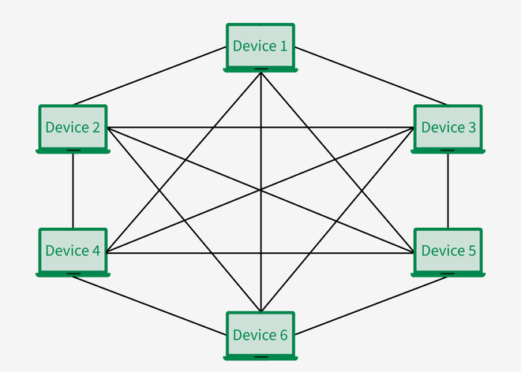
Mesh Topology
In a mesh topology, every device is connected to another device via a particular channel.
Every device is connected to another via dedicated channels. These channels are known as links.
In Mesh Topology, the protocols used are AHCP (Ad Hoc Configuration Protocols), DHCP (Dynamic Host Configuration Protocol), etc.

Slide 18
Suppose, the N number of devices are connected with each other in a mesh topology, the total number of ports that are required by each device is N−1. In Figure , there are 6 devices connected to each other, hence the total number of ports required by each device is 5. The total number of ports required = N * (N-1)
Suppose, N number of devices are connected with each other in a mesh topology, then the total number of dedicated links required to connect them is NC2​ i.e. N * (N-1)/2. In Figure, there are 6 devices connected to each other, hence the total number of links required is 6 * 5/2 = 15.
Advantages of Mesh Topology
Communication is very fast between the nodes.
Mesh Topology is robust.
The fault is diagnosed easily. Data is reliable because data is transferred among the devices through dedicated channels or links.
Provides security and privacy.
Disadvantages of Mesh Topology
Installation and configuration are difficult.
The cost of cables is high as bulk wiring is required, hence suitable for less number of devices.
The cost of maintenance is high.
Note: A common example of mesh topology is the internet backbone, where various internet service providers are connected to each other via dedicated channels. This topology is also used in military communication systems and aircraft navigation systems.

Slide 19
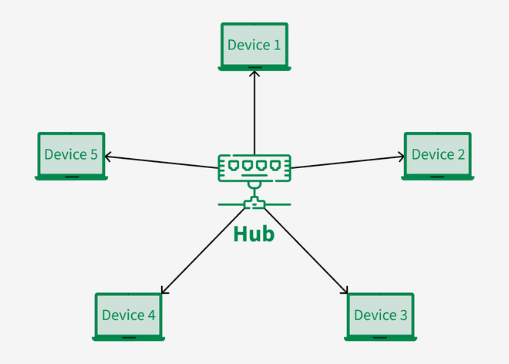
Star Topology
In Star Topology, all the devices are connected to a single hub through a cable.
This hub is the central node and all other nodes are connected to the central node.
The hub can be passive in nature i.e., not an intelligent hub such as broadcasting devices, at the same time the hub can be intelligent known as an active hub. Active hubs have repeaters in them.
Note: Here, Coaxial cables or RJ-45 cables are used to connect the computers & many popular Ethernet LAN protocols are used as CD(Collision Detection), CSMA (Carrier Sense Multiple Access), etc.

Slide 20
Advantages of Star Topology
If N devices are connected to each other in a star topology, then the number of cables required to connect them is N. So, it is easy to set up.
Each device requires only 1 port i.e. to connect to the hub, therefore the total number of ports required is N.
It is Robust. If one link fails only that link will affect and not other than that.
Easy to fault identification and fault isolation.
Star topology is cost-effective as it uses inexpensive coaxial cable.
Disadvantages of Star Topology
If the concentrator (hub) on which the whole topology relies fails, the whole system will crash down.
The cost of installation is high.
Performance is based on the single concentrator i.e. hub.
Note: A common example of star topology is a local area network (LAN) in an office where all computers are connected to a central hub. This topology is also used in wireless networks where all devices are connected to a wireless access point.

Slide 21
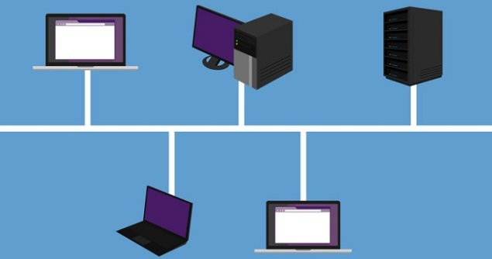
Bus Topology
In case of Bus topology, all devices share single communication line or cable.Bus topology may have problem while multiple hosts sending data at the same time.
Therefore, Bus topology either uses CSMA/CD technology or recognizes one host as Bus Master to solve the issue. It is one of the simple forms of networking where a failure of a device does not affect the other devices.
But failure of the shared communication line can make all other devices stop functioning.
Both ends of the shared channel have line terminator. The data is sent in only one direction and as soon as it reaches the extreme end, the terminator removes the data from the line.

Slide 22
Advantages of Bus Topology
If N devices are connected to each other in a bus topology, then the number of cables required to connect them is 1, known as backbone cable, and N drop lines are required.
Coaxial or twisted pair cables are mainly used in bus-based networks that support up to 10 Mbps.
The cost of the cable is less compared to other topologies, but it is used to build small networks.
Bus topology is familiar technology as installation and troubleshooting techniques are well known.
CSMA is the most common method for this type of topology.
Disadvantages of Bus Topology
A bus topology is quite simpler, but still, it requires a lot of cabling.
If the common cable fails, then the whole system will crash down.
If the network traffic is heavy, it increases collisions in the network. To avoid this, various protocols are used in the MAC layer known as Pure Aloha, Slotted Aloha, CSMA/CD, etc.
Adding new devices to the network would slow down networks.
Security is very low.
Note: A common example of bus topology is the Ethernet LAN, where all devices are connected to a single coaxial cable or twisted pair cable. This topology is also used in cable television networks.

Slide 23
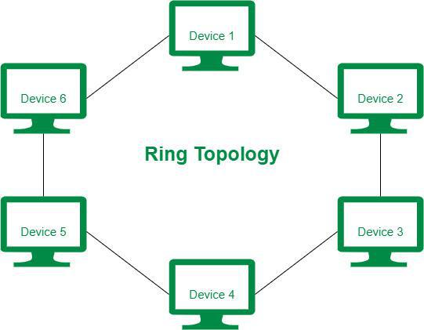
Ring Topology
In a Ring Topology, it forms a ring connecting devices with exactly two neighboring devices. A number of repeaters are used for Ring topology with a large number of nodes, because if someone wants to send some data to the last node in the ring topology with 100 nodes, then the data will have to pass through 99 nodes to reach the 100th node. Hence to prevent data loss repeaters are used in the network.
In-Ring Topology, the Token Ring Passing protocol is used by the workstations to transmit the data where, Token passing is a network access method in which a token is passed from one node to another node & Token is a frame that circulates around the network.
Note: Here, data flows in one direction, but it can be made bidirectional by having 2 connections between each Network Node, it is called Dual Ring Topology.

Slide 24
Operations of Ring Topology
One station is known as a monitor station which takes all the responsibility for performing the operations.
To transmit the data, the station has to hold the token. After the transmission is done, the token is to be released for other stations to use.
When no station is transmitting the data, then the token will circulate in the ring.
Advantages of Ring Topology
The data transmission is high-speed.
The possibility of collision is minimum in this type of topology.
Cheap to install and expand.
Disadvantages of Ring Topology
The failure of a single node in the network can cause the entire network to fail.
Troubleshooting is difficult in this topology.
Less secure.

Slide 25
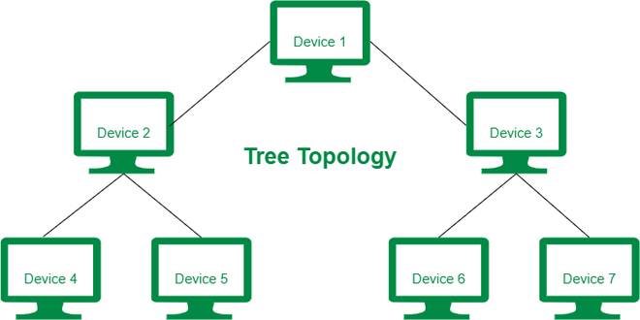
Tree Topology
Tree topology is the variation of the Star topology. This topology has a hierarchical flow of data. In Tree Topology, protocols like DHCP and SAC (Standard Automatic Configuration) are used.
Here, various secondary hubs are connected to the central hub which contains the repeater.
This data flow from top to bottom i.e. from the central hub to the secondary and then to the devices or from bottom to top i.e. devices to the secondary hub and then to the central hub.
It is a multi-point connection and a non-robust topology because if the backbone fails the topology crashes.

Slide 26
Advantages of Tree Topology
It allows more devices to be attached to a single central hub thus it decreases the distance that is traveled by the signal to come to the devices.
It allows the network to get isolated and also prioritize from different computers.
We can add new devices to the existing network.
Disadvantages of Tree Topology
If the central hub gets fails the entire system fails.
The cost is high because of the cabling.
If new devices are added, it becomes difficult to reconfigure.
Note: A common example of a tree topology is the hierarchy in a large organization. CEO is the root, who is connected to the different departments(child nodes) of the company, managers overseeing different teams (grandchild nodes) & team members (leaf nodes) are at the bottom of the hierarchy.

Slide 27
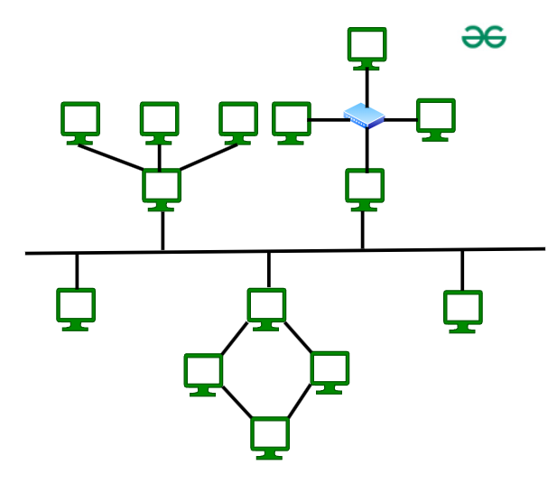
Hybrid Topology
Hybrid Topology is the combination of all the various types of topologies we have studied above. Hybrid Topology is used when the nodes are free to take any form. It means these can be individuals such as Ring or Star topology or can be a combination of various types of topologies seen above. Each individual topology uses the protocol that has been discussed earlier.

Slide 28
Advantages of Hybrid Topology
This topology is very flexible.
The size of the network can be easily expanded by adding new devices.
Disadvantages of Hybrid Topology
It is challenging to design the architecture of the Hybrid Network.
Hubs used in this topology are very expensive.
The infrastructure cost is very high as a hybrid network requires a lot of cabling and network devices .
Note: A common example of a hybrid topology is a university campus network. The network may have a backbone of a star topology, with each building connected to the backbone through a switch or router. Within each building, there may be a bus or ring topology connecting the different rooms and offices.

Slide 29
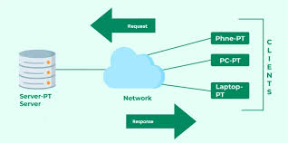
Client Server Model
The client–server model is a network architecture where work is divided between two main components: clients and servers. It is one of the most widely used models in modern computing and forms the foundation of most business networks, web applications, banking systems and cloud services.
The client–server model is a system where multiple client devices request services, and a central server responds to those requests. Clients send a request such as “fetch this file,” “save this data,” or “authenticate this user,” and the server processes the request and sends back the result.
The client and server communicate over a network using standard protocols like HTTP, TCP/IP, SMTP, FTP and others.

Slide 30
Components of Client Server Model
Client
A client is a device or software that asks for a service.
It can be a computer, mobile phone, browser, or application.
Clients initiate communication but do not typically provide services to other devices.
Examples: Web browsers, mobile apps, ATMs, email clients, database clients.
Server
A server is a powerful computer or program that stores data, manages resources, and provides services to clients.
It stays active 24/7 to handle incoming requests.
It processes requests, performs required operations and returns results.
Examples: Web servers, database servers, application servers, file servers.

Slide 31
How Client Server works
The client sends a request to the server through the network.
The server receives the request, processes it, and retrieves or updates the data.
The server sends the response back to the client.
The client receives the output and displays or uses it.
This happens very quickly, often in milliseconds.
Types of Servers in the Client–Server Architecture
File Server: Stores documents and files that clients can download, upload or edit.
Database Server: Manages large databases and responds to client queries (SQL commands).
Web Server: Delivers web pages and content to browsers.
Application Server: Runs business logic and processes complex tasks for clients.
Mail Server: Handles sending and receiving emails for users.
Print Server: Manages printers and print requests in an organisation.

Slide 32
Features of the Client–Server Model
Centralised Resources
All important data, files, and applications are stored in one place—the server. This makes management easier and more secure.
Improved Security
Since everything is controlled centrally, administrators can enforce strong security policies, passwords, access rules and backups.
Scalability
More clients can be added easily without redesigning the whole network. Servers can be upgraded when the workload increases.
Reliability
Servers are usually high-performance machines with backup systems, making the network stable and consistent.

Slide 33
Advantages and Disadvantages
Advantages
Centralised management of data, security and resources.
High performance because servers are powerful.
Easier maintenance since updates can be applied in one place.
Better security due to controlled access.
Supports large networks with thousands of users.
Reliable backups and disaster recovery options.
Disadvantages
Expensive to set up, because servers cost more.
Server becomes a single point of failure; if it goes down, services stop.
Requires trained administrators to maintain and secure the network.
Performance issues may occur if too many clients request resources at once.
Real-Life Examples of the Client–Server Model
a. Online Banking
Your phone (client) requests your balance; the bank’s server sends the balance.
b. Websites
You open a website on your browser (client); the web server delivers HTML, images and data.
c. Email
Your Gmail app (client) connects to Google’s mail servers to fetch or send emails.
d. Company Networks
Employees access shared files, databases or applications stored on central servers.

Slide 34
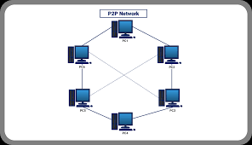
Peer-to-Peer (P2P) Network
A Peer-to-Peer (P2P) network is a type of computer network where all devices, called peers, share resources and communicate directly with each other. Unlike the client–server model, there is no central server managing the network. Each device can act both as a client and a server at the same time.
P2P networks are commonly used in homes, small offices and applications like file sharing, blockchain and online collaboration.
A peer-to-peer network is a decentralised network where each computer (peer) has equal status and responsibilities. Every device can:
Store its own data
Share files or resources with others
Request data from other peers
There is no central authority controlling the network, which makes it simple, flexible and inexpensive.

Slide 35
How a P2P Network Works
Each peer connects to the network using wired or wireless connections.
When a peer needs a file or resource, it searches for it among other peers.
Another peer containing that resource shares it directly with the requesting peer.
Both peers communicate directly without involving a central server.
This direct communication reduces dependency and improves speed in many cases.
Key Characteristics of P2P Networks
No Central Server
Resources are distributed among all devices. Each peer manages its own files, permissions and processing tasks.
Equal Participation
All devices are equal. A peer can be both a service requester and a service provider.
Easy to Set Up
There is no complex server installation. Anyone can create a small P2P network at home or in a small office.
Lower Cost
No need for expensive servers or network administrators. It works well on regular computers and home devices.
Distributed Resources
Files and data are shared across multiple devices, not stored in one central place.

Slide 36
Advantages and Disadvantages
Advantages
Cost-Effective: No expensive servers are required, making it perfect for small networks and personal use.
Easy Maintenance: Users manage their own devices. No need for dedicated IT staff.
High Scalability: New peers can join or leave without disturbing the network. More peers often means more shared resources.
Reduced Traffic on Central Server: Because peers share directly, there is no overload on a single machine.
Strong in Distributed Applications: Many modern distributed technologies use P2P principles, such as blockchain.
Disadvantages
Weaker Security
No central authority means each user must secure their own device. Malware or viruses can spread easily through shared files.
Harder to Manage
Since everyone controls their own resources, enforcing rules is difficult.
Data Duplication or Inconsistency
Files may not be updated everywhere because data is scattered among peers.
Lower Performance for Large Organisations
P2P is not ideal for large networks with heavy workloads. Client/server systems are more stable for such environments.

Slide 37
Types of P2P
Pure P2P
Every peer has equal roles without any central directory. Example: early file-sharing systems like Gnutella.
Hybrid P2P
A central server exists only to help peers find each other, but sharing happens directly between peers. Example: BitTorrent (tracker-based).
Structured P2P
Uses algorithms to organise peers and data in a structured way for faster searches. Example: Distributed Hash Tables (DHT).
Real-Life Examples of P2P Networks
File-Sharing Applications
BitTorrent
LimeWire (old)
eMule
Peers exchange files directly without a central server.
Blockchain and Cryptocurrencies
Bitcoin and Ethereum use P2P networks to validate transactions. Every node stores a copy of the ledger.
Communication Apps
Some messaging or VoIP systems use P2P for direct device-to-device calls.
Home and Small Office Networks
Sharing files, printers or media across a few computers at home is usually P2P.

Slide 38
Differences
Basis | Client–Server Network | Peer-to-Peer (P2P) Network
1. Structure | Uses a central server to provide services to clients. | All computers (peers) are equal and share resources directly.
2. Control | Centralised control. Server manages everything. | No central control. Each peer manages its own resources.
3. Dependency | Network depends heavily on the server. | No single point of failure; peers can still work independently.
4. Cost | More expensive due to server hardware and maintenance. | Very low cost. No special server is needed.
5. Setup & Maintenance | Harder to set up and requires trained administrators. | Easy to set up; users manage their own devices.
6. Security | Strong security because the server controls user access. | Weaker security since each peer manages its own protection.
7. Performance | High performance, suitable for large networks. | Suitable only for small networks with fewer users.
8. Data Storage | Data is stored centrally on the server. | Data is distributed across multiple peers.
9. Scalability | Easily scalable by upgrading the server. | Hard to scale; too many peers reduce performance.
10. Examples | Banks, websites, offices, email servers. | Torrent software, home networks, small file sharing.

Slide 39
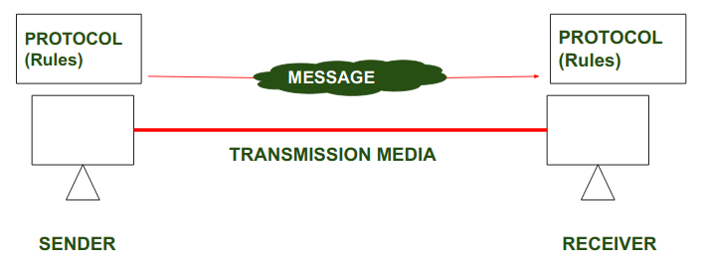
Protocol and Standards
A protocol is a set of rules that determines how data is sent and received over a network. The protocol is just like a language that computers use to talk to each other, ensuring they understand and can respond to each other's messages correctly. Protocols help make sure that data moves smoothly and securely between devices on a network.
To make communication successful between devices, some rules and procedures should be agreed upon at the sending and receiving ends of the system. Such rules and procedures are called Protocols. Different types of protocols are used for different types of communication.

Slide 40
Key Elements of Protocol
Syntax: Syntax refers to the structure or the format of the data that gets exchanged between the devices. Syntax of the message includes the type of data, composition of the message, and sequencing of the message. The starting 8 bits of data are considered as the address of the sender. The next 8 bits are considered to be the address of the receiver. The remaining bits are considered as the message itself.
Semantics: Semantics defines data transmitted between devices. It provides rules and norms for understanding message or data element values and actions.
Timing: Timing refers to the synchronization and coordination between devices while transferring the data. Timing ensures at what time data should be sent and how fast data can be sent. For example, If a sender sends 100 Mbps but the receiver can only handle 1 Mbps, the receiver will overflow and lose data. Timing ensures preventing of data loss, collisions, and other timing-related issues.
Sequence Control: Sequence control ensures the proper ordering of data packets. The main responsibility of sequence control is to acknowledge the data while it get received, and the retransmission of lost data. Through this mechanism, the data is delivered in correct order.
Flow Control: Flow control regulates device data delivery. It limits the sender's data or asks the receiver if it's ready for more. Flow control prevents data congestion and loss.
Error Control: Error control mechanisms detect and fix data transmission faults. They include error detection codes, data resend, and error recovery. Error control detects and corrects noise, interference, and other problems to maintain data integrity.
Security : Network security protects data confidentiality, integrity, and authenticity. which includes encryption, authentication, access control, and other security procedures. Network communication's privacy and trustworthiness are protected by security standards.

Slide 41
Types of Protocols
Network Layer Protocols : Network layer protocols operate in the network layer which is also known as the Layer 3 of the network architecture. Network layer protocols are responsible for packet routing, forwarding, and addressing of data packets throughout the network. IP and ICMP are the network layer protocols.
Transport Layer Protocols: Transport layer protocols work in the transport layer which provides end-to-end service ensuring data transfer across apps on different devices. TCP and UDP are the most popular transport layer protocols.
Application Layer Protocol: Application layer protocol working in the application layer of the network architecture provides communication between applications running on different devices. The application layer protocols enable cross-device communication. They format, exchange, and interpret application data. HTTP, FTP, and SMTP are examples.
Wireless Protocols: Wireless protocols basically used in wireless communication which enables data transfer through wireless networks. Bluetooth, Wi-Fi, and LTE protocols are examples.
Routing Protocols: Routing protocol establishes the best/optimal network pathways throughout the network for fastest data transmission. Routers share information to develop and maintain routing tables. RIP, OSPF, and BGP are examples.
Security Protocols : security protocol protects data confidentiality, integrity, and authenticity while transmission of data over the network. They include SSL and TLS, encryption methods, and authentication protocols for providing data security.
Internet Protocols : IP identifies devices uniquely. Internet protocol provides data communication through routing and forwarding data packets from one device to another by unique addressing scheme.

Slide 42
Important Protocols Used in Computer Network
TCP (Transmission Control Protocol): Ensures data is sent and received accurately by breaking it into packets, sending them, and reassembling them at the destination.
IP (Internet Protocol): Addresses and routes the packets to make sure they reach the right destination.
HTTP/HTTPS (HyperText Transfer Protocol/Secure): HTTP used for transferring web pages on the internet. When you browse a website, your browser uses HTTP to request and display web pages. And HTTPs is a secure version of HTTP that encrypts data to protect it from being intercepted.
FTP (File Transfer Protocol): Used for transferring files between computers on a network. It allows users to upload and download files.SMTP (Simple Mail Transfer Protocol): Used for sending emails. It transfers emails from a client to a server or between servers.
DNS (Domain Name System): It is used to translates human-readable domain names (like www.example.com) into IP addresses that computers use to identify each other on the network.
DHCP (Dynamic Host Configuration Protocol): Automatically assigns IP addresses to devices on a network, ensuring each device has a unique address.
SSH (Secure Shell): Provides a secure way to access and manage devices over a network. It encrypts the data, making it safe from eavesdropping.
SNMP (Simple Network Management Protocol): Used for managing and monitoring network devices like routers, switches, and servers. It collects and organizes information about these devices

Slide 43
Standards
Standards are the set of rules for data communication that are needed for the exchange of information among devices. It is important to follow Standards which are created by various Standard Organizations like IEEE, ISO, ANSI, etc.
Types of Standards
De Facto Standard: The meaning of the word " De Facto " is " By Fact " or "By Convention". These are the standards that have not been approved by any Organization but have been adopted as Standards because of their widespread use. Also, sometimes these standards are often established by Manufacturers. For example : Apple and Google are two companies that established their own rules for their products which are different. Also, they use some same standard rules for manufacturing their products.
De Jure Standard: The meaning of the word "De Jure" is "By Law" or "By Regulations".Thus, these are the standards that have been approved by officially recognized bodies like ANSI, ISO, IEEE, etc. These are the standards that are important to follow if it is required or needed. For example : All the data communication standard protocols like SMTP, TCP, IP, UDP etc. are important to follow the same when we need them.

Slide 44
Protocol and Standard Compliance in Network Security
1. Ensures Interoperability
Devices and software from different companies can communicate and work together only when they follow the same standards. For example, a laptop from Dell can connect to a Wi-Fi router from TP-Link because both follow IEEE standards. This allows users to mix different brands without any issues.
2. Compatibility Across the World
Standardization ensures that technologies developed in one country work the same way everywhere else. This is important for global products like routers, mobile phones and servers. It allows internet communication to function the same in every part of the world.
3. Reduces Technical Conflicts
Without standards, hardware and software would not follow common rules, leading to errors or failures. Standardization reduces confusion by defining clear guidelines for data formats, wiring, protocols and communication methods. This makes network setup and troubleshooting easier.
4. Improves Network Reliability and Performance
Standard rules ensure that all components behave predictably. This avoids crashes, data loss and communication delays. Reliable networks improve user experience and support critical applications like banking, healthcare and business operations
5. Enhances Security
Standards include security guidelines for encryption, authentication, data protection and safe communication. This protects networks from hacking, data breaches and cyber-attacks. Secure standards are essential for online banking, e-commerce and government systems.
6. Simplifies Development and Innovation
When developers follow common standards, they can build devices and software more quickly. This avoids reinventing the wheel and encourages innovation. New technologies like 5G, cloud computing and IoT grow faster because they follow existing standards.
7. Reduces Cost
Standardization lowers production and operational costs. Manufacturers don’t need to create different versions of the same device for different markets. Users can upgrade or replace parts easily because standard components fit universally.
8. Facilitates Global Communication
The internet works smoothly worldwide because everyone follows standards such as TCP/IP, DNS and HTTP. These standards make global data exchange seamless and efficient. Without them, international communication would be nearly impossible.

Slide 45
Major Organizations That Develop Network Standards
1. IEEE (Institute of Electrical and Electronics Engineers)
The IEEE is one of the most influential bodies in networking technology. It develops standards for network hardware, communication protocols and wireless technologies.
Key Contributions
IEEE 802.3 – Ethernet standards
IEEE 802.11 – Wi-Fi standards
IEEE 802.15 – Bluetooth and personal networks
LAN/MAN standards
IEEE standards are used in almost every computer network today.
2. ISO (International Organization for Standardization)
ISO develops worldwide standards for technology, business and quality management. In networking, ISO is known mainly for the OSI Reference Model.
Key Contributions
OSI (Open Systems Interconnection) model
Standardisation of network layers
International compatibility for network systems
ISO helps ensure that devices from different companies can communicate using the same architecture.
3. IETF (Internet Engineering Task Force)
IETF focuses on developing and maintaining standards for the internet. It creates open, high-quality technical documents called RFCs (Request for Comments).
Key Contributions
TCP/IP protocols
HTTP, SMTP, DNS, DHCP standards
Internet routing protocols
Security standards (TLS, IPsec)
Almost all internet technologies rely on IETF standards.
4. ITU (International Telecommunication Union)
The ITU is a United Nations agency responsible for global telecommunication standards. It ensures smooth international communication across phone networks, satellites, and data services.
Key Contributions
ITU-T – Telecommunication standards
ITU-R – Radio communication standards
Video/audio coding standards (e.g., H.264, H.265)
Broadband and mobile network guidelines
ITU plays a crucial role in global telecom regulation.

Slide 46
Organisation | Full Form | Main Contributions
IEEE | Institute of Electrical and Electronics Engineers | Ethernet, Wi-Fi, Bluetooth
ISO | International Organization for Standardization | OSI model, global compatibility
IETF | Internet Engineering Task Force | Internet protocols (TCP/IP, HTTP, DNS)
ITU | International Telecommunication Union | Telecom, radio, video standards
W3C | World Wide Web Consortium | Web standards (HTML, CSS)
ANSI | American National Standards Institute | Data formats, character sets
ETSI | European Telecommunications Standards Institute | GSM, LTE, mobile stand

Slide 47
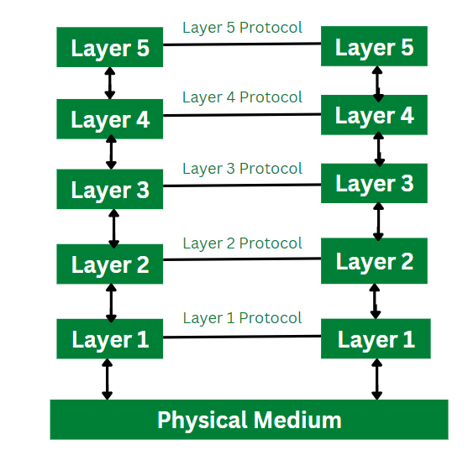
Layered Architecture
Every network consists of a specific number of functions, layers, and tasks to perform.
Layered Architecture in a computer network is defined as a model where a whole network process is divided into various smaller sub-tasks. These divided sub-tasks are then assigned to a specific layer to perform only the dedicated tasks. A single layer performs only a specific type of task.
To run the application and provide all types of services to clients a lower layer adds its services to the higher layer present above it. Therefore layered architecture provides interactions between the sub-systems. If any type of modification is done in one layer it does not affect the next layer.

Slide 48
Features of Layered Architecture
Use of Layered architecture in computer network provides with the feature of modularity and distinct interfaces.
Layered architecture ensures independence between layers, by offering services to higher layers from the lower layers and without specifying how these services are implemented.
Layered architecture segments as larger and unmanageable design into small sub tasks.
In layer architecture every network has different number of functions, layers and content.
In layered architecture, the physical route provides with communication which is available under the layer 1.
In layered architecture, the implementation done by one layer can be modified by another layer.
Elements of Layered Architecture
There are three different types of elements of a layered architecture. They are described below:
Service: Service is defined as a set of functions and tasks being provided by a lower layer to a higher layer. Each layer performs a different type of task. Therefore, actions provided by each layer are different.
Protocol: Protocol is defined as a set rule used by the layer for exchanging and transmission of data with its peer entities. These rules can consists details regarding a type of content and their order passed from one layer to another.
Interface: Interface is defined as a channel that allows to transmit the messages from one layer to the another.

Slide 49
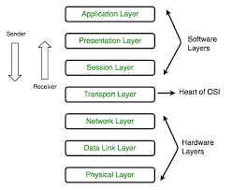
OSI Model
The OSI (Open Systems Interconnection) Model is a set of rules that explains how different computer systems communicate over a network. OSI Model was developed by the International Organization for Standardization (ISO). The OSI Model consists of 7 layers and each layer has specific functions and responsibilities. This layered approach makes it easier for different devices and technologies to work together.
Layers of the OSI Model
There are 7 layers in the OSI Model and each layer has its specific role in handling data. All the layers are mentioned below:
Physical Layer
Data Link Layer
Network Layer
Transport Layer
Session Layer
Presentation Layer
Application Layer

Slide 50
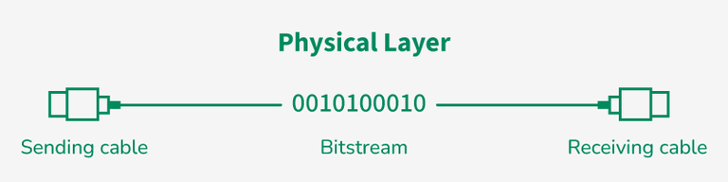
Physical Layer
Layer 1: Physical Layer
The lowest layer of the OSI reference model is the Physical Layer. It is responsible for the actual physical connection between the devices. The physical layer contains information in the form of bits.
Physical Layer is responsible for transmitting individual bits from one node to the next.
When receiving data, this layer will get the signal received and convert it into 0s and 1s and send them to the Data Link layer, which will put the frame back together.
Common physical layer devices are Hub, Repeater, Modem, and Cables.

Slide 51
Data Link Layer
Layer 2: Data Link Layer (DLL)
The data link layer is responsible for the node-to-node delivery of the message. The main function of this layer is to make sure data transfer is error-free from one node to another, over the physical layer.
When a packet arrives in a network, it is the responsibility of the DLL to transmit it to the Host using its MAC address.
Packet in the Data Link layer is referred to as Frame. Switches and Bridges are common Data Link Layer devices.
The packet received from the Network layer is further divided into frames depending on the frame size of the NIC (Network Interface Card). DLL also encapsulates Sender and Receiver’s MAC address in the header.
The Receiver’s MAC address is obtained by placing an ARP (Address Resolution Protocol) request onto the wire asking, "Who has that IP address?" and the destination host will reply with its MAC address.

Slide 52
Network Layer
Layer 3: Network Layer
The network layer works for the transmission of data from one host to the other located in different networks. It also takes care of packet routing i.e. selection of the shortest path to transmit the packet, from the number of routes available.
The sender and receiver's IP address are placed in the header by the network layer. Segment in the Network layer is referred to as Packet.
Network layer is implemented by networking devices such as routers and switches.
Functions of the Network Layer
Routing: The network layer protocols determine which route is suitable from source to destination. This function of the network layer is known as routing.
Logical Addressing: To identify each device inter-network uniquely, the network layer defines an addressing scheme. The sender and receiver’s IP addresses are placed in the header by the network layer. Such an address distinguishes each device uniquely and universally.

Slide 53
Transport Layer
Layer 4: Transport Layer
The transport layer provides services to the application layer and takes services from the network layer. The data in the transport layer is referred to as Segments. It is responsible for the end-to-end delivery of the complete message.
The transport layer also provides the acknowledgment of the successful data transmission and re-transmits the data if an error is found.
Protocols used in Transport Layer are TCP, UDP NetBIOS, PPTP.
At the sender's side, the transport layer receives the formatted data from the upper layers, performs Segmentation, and also implements Flow and error control to ensure proper data transmission.
It also adds Source and Destination port number in its header and forwards the segmented data to the Network Layer.
Generally, this destination port number is configured, either by default or manually.
Example: when a web application requests a web server, it typically uses port number 80, because this is the default port assigned to web applications. Many applications have default ports assigned.
At the Receiver’s side, Transport Layer reads the port number from its header and forwards the Data which it has received to the respective application. It also performs sequencing and reassembling of the segmented data.

Slide 54
Session Layer
Layer 5: Session Layer
Session Layer in the OSI Model is responsible for the establishment of connections, management of connections, terminations of sessions between two devices. It also provides authentication and security. Protocols used in the Session Layer are NetBIOS, PPTP.
Functions of the Session Layer
Session Establishment, Maintenance, and Termination: The layer allows the two processes to establish, use, and terminate a connection.
Synchronization: This layer allows a process to add checkpoints that are considered synchronization points in the data. These synchronization points help to identify the error so that the data is re-synchronized properly, and ends of the messages are not cut prematurely, and data loss is avoided.
Dialog Controller: The session layer allows two systems to start communication with each other in half-duplex or full duplex.
Example
Let us consider a scenario where a user wants to send a message through some Messenger application running in their browser. The “Messenger” here acts as the application layer which provides the user with an interface to create the data. This message or so-called Data is compressed, optionally encrypted (if the data is sensitive), and converted into bits (0’s and 1’s) so that it can be transmitted.

Slide 55
Presentation Layer
Layer 6: Presentation Layer
The presentation layer is also called the Translation layer. The data from the application layer is extracted here and manipulated as per the required format to transmit over the network. Protocols used in the Presentation Layer are TLS/SSL (Transport Layer Security / Secure Sockets Layer).JPEG, MPEG, GIF, are standards or formats used for encoding data, which is part of the presentation layer’s role.
Functions of the Presentation Layer
Translation: For example, ASCII to EBCDIC.
Encryption/ Decryption: Data encryption translates the data into another form or code. The encrypted data is known as the ciphertext, and the decrypted data is known as plain text. A key value is used for encrypting as well as decrypting data.
Compression: Reduces the number of bits that need to be transmitted on the network.

Slide 56
Application Layer
Layer 7: Application Layer
At the very top of the OSI Reference Model stack of layers, we find the Application layer which is implemented by the network applications. These applications produce the data to be transferred over the network.
This layer also serves as a window for the application services to access the network and for displaying the received information to the user.
Protocols used in the Application layer are SMTP, FTP, DNS, etc.

Slide 57
Data Flowing When Sending
Layer 3: Network Layer
Segments become packets. The sender’s and receiver’s IP addresses are added. Routing decisions are made.
Layer 2: Data Link Layer
Packets become frames. MAC addresses are added for local network delivery. Error detection for local transmission also happens here.
Layer 1: Physical Layer
Frames become bits (0s and 1s). These bits are transmitted through cables or wireless signals.
The sender moves data downward from Layer 7 to Layer 1.
Layer 7: Application Layer
The user interacts with the network through apps like email, browsers or chat. The application creates the original data.
Layer 6: Presentation Layer
This layer formats the data. It may encrypt, compress, or translate it into a standard format.
Layer 5: Session Layer
It starts, manages and ends communication sessions. Data is prepared for transport.
Layer 4: Transport Layer
Data becomes segments. TCP/UDP adds port numbers, ensures error checking, flow control and reliable delivery.

Slide 58
Step 1: Person A interacts with e-mail application like Gmail, outlook, etc. Writes his email to send. (This happens at Application Layer).
Step 2: At Presentation Layer, Mail application prepares for data transmission like encrypting data and formatting it for transmission.
Step 3: At Session Layer, there is a connection established between the sender and receiver on the internet.
Step 4: At Transport Layer, Email data is broken into smaller segments. It adds sequence number and error-checking information to maintain the reliability of the information.
Step 5: At Network Layer, addressing of packets is done in order to find the best route for transfer.
Step 6: At Data Link Layer, data packets are encapsulated into frames, then MAC address is added for local devices and then it checks for error using error detection.
Step 7: At Physical Layer, Frames are transmitted in the form of electrical/ optical signals over a physical network medium like ethernet cable or WiFi.

Slide 59
Data flow while receiving
Layer 1 → Layer 2
The physical layer receives raw bits. They are converted back into frames.
Layer 2 → Layer 3
Frames are checked for errors. MAC addresses are removed, and packets are passed up.
Layer 3 → Layer 4
Packets are checked for IP addresses and routing info. Port numbers are used to deliver data to the right application. Segments are formed again.
Layer 4 → Layer 5
Transport layer reorders the segments if needed and removes transport headers. Data becomes a continuous stream.
Layer 5 → Layer 6
Session layer maintains the session. Presentation layer decrypts or decompresses the data.
Layer 6 → Layer 7
Application layer delivers the final output to the user. For example, the web page loads on your browser.

Slide 60
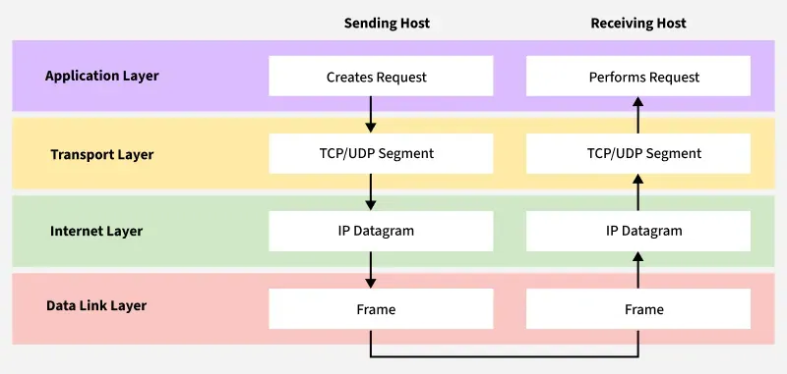
TCP/IP Model
The TCP/IP model is a framework that is used to model the communication in a network. It is mainly a collection of network protocols and organization of these protocols in different layers for modeling the network.
It has four layers, Application, Transport, Network/Internet and Network Access.
While the OSI model has seven layers, the 4 layer TCP/IP model is simpler and commonly used in today’s Internet and networking systems.
One of its main goals is to make sure that the data sent by the sender arrives safely and correctly at the receiver’s end. To do this, the data is broken down into smaller parts called packets before being sent. These packets travel separately and are reassembled in the correct order when they reach the destination.

Slide 61
Layers of TCP/IP Model
1. Application Layer
The Application Layer is the top layer of the TCP/IP model and the one closest to the user. This is where all the apps you use like web browsers, email clients, or file sharing tools connect to the network.
It acts like a bridge between your software (like Chrome, Gmail, or WhatsApp) and the lower layers of the network that actually send and receive data.
It supports different protocols like HTTP (for websites), FTP (for file transfers), SMTP (for emails), and DNS (for finding website addresses).
It also manages things like data formatting, so both sender and receiver understand the data, encryption to keep data safe, and session management to keep track of ongoing connections.
2. Transport Layer
The Transport Layer is responsible for making sure that data is sent reliably and in the correct order between devices. It checks that the data you send like a message, file, or video arrives safely and completely.
This layer uses two main protocols: TCP and UDP, depending on whether the communication needs to be reliable or faster.
TCP is used when data must be correct and complete, like when loading a web page or downloading a file.
It checks for errors, resends missing pieces, and keeps everything in order. On the other hand, UDP (User Datagram Protocol) is faster but doesn’t guarantee delivery useful for things like live video or online games where speed matters more than perfect accuracy.

Slide 62
3. Internet Layer
The Internet Layer is used for finding the best path for data to travel across different networks so it can reach the right destination. It works like a traffic controller, helping data packets move from one network to another until they reach the correct device.
This layer uses the Internet Protocol (IP) to give every device a unique IP address, which helps identify where data should go.
The main job of this layer is routing deciding the best way for data to travel.
It also takes care of packet forwarding (moving data from one point to another), fragmentation (breaking large data into smaller parts), and addressing.
4. Network Access Layer
The Network Access Layer is the bottom layer of the TCP/IP model. It deals with the actual physical connection between devices on the same local network like computers connected by cables or communicating through Wi-Fi.
This layer makes sure that data can travel over the hardware, such as wires, switches, or wireless signals.
It also handles important tasks like using MAC addresses to identify devices, creating frames (the format used to send data over the physical link), and checking for basic errors during transmission.

Slide 63
Working of TCP/IP Layer
When Sending Data (From Sender to Receiver)
Application Layer: Prepares user data using protocols like HTTP, FTP, or SMTP.
Transport Layer (TCP/UDP): Breaks data into segments and ensures reliable (TCP) or fast (UDP) delivery.
Internet Layer (IP): Adds IP addresses and decides the best route for each packet.
Link Layer (Network Access Layer): Converts packets into frames and sends them over the physical network.
When Receiving Data (At the Destination)
Link Layer: Receives bits from the network and rebuilds frames to pass to the next layer.
Internet Layer: Checks the IP address, removes the IP header, and forwards data to the Transport Layer.
Transport Layer: Reassembles segments, checks for errors, and ensures data is complete.
Application Layer: Delivers the final data to the correct application (e.g., displays a web page in the browser).

Slide 64
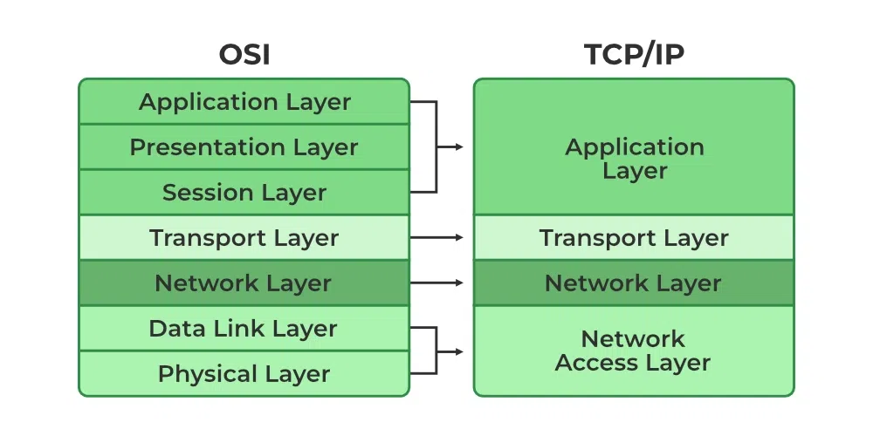
Why TCP/IP is Used Over the OSI Model
Reason | Explanation
Simpler Structure | TCP/IP has only 4 layers, compared to 7 in OSI, making it easier to implement and understand in real systems.
Protocol-Driven Design | TCP/IP was designed based on working protocols, while the OSI model is more of a theoretical framework.
Flexibility and Robustness | TCP/IP adapts well to different hardware and networks and includes error handling, routing, and congestion control.
Open Standard | TCP/IP is open, free to use, and not controlled by any single organization, helping it gain universal acceptance.
Actual Use vs Conceptual Model | The OSI model is great for education and design principles, but TCP/IP is the one actually used in real-world networking.

Slide 65
Aspect | OSI Model | TCP/IP Model
Number of Layers | 7 Layers | 4 Layers
Layer Structure | More detailed and strict separation | More flexible, fewer layers
Development | ISO (theoretical, reference model) | U.S. Department of Defense (practical, used in the real world)
Protocol | Protocol-independent | Protocol-dependent (specific protocols defined)
Application | Used as a guide for designing networks | Used to develop actual Internet systems
Examples of Protocols | HTTP, FTP, SMTP, TCP, IP | TCP, IP, HTTP, DNS, FTP

Slide 66
Addressing at Different Layers
1. Application Layer (Layer 7)
Addressing Type: Application Addresses (e.g., Domain Names, URLs)
Explanation: At the Application Layer, addressing is more about identifying applications or services on devices. It includes things like:
Domain Names (e.g., www.example.com), URLs (Uniform Resource Locators) that specify the location of a web page or service
The Application Layer doesn’t directly deal with network-level addresses but works with higher-level identifiers such as web addresses, email addresses, and file paths to provide services to the user.
2. Presentation Layer (Layer 6)
Addressing Type: Data Encoding Addressing
Explanation: At the Presentation Layer, addressing mainly involves encoding and formatting data for the receiver. There is no "addressing" in the traditional sense here. This layer focuses on:
Data Translation (converting between formats like EBCDIC to ASCII)
Encryption/Decryption for secure transmission
Compression to optimize data for transmission
3. Session Layer (Layer 5)
Addressing Type: Session Identifiers
Explanation: At the Session Layer, the concept of addressing is related to managing sessions between devices.
It ensures that data is transferred correctly between devices by managing session IDs (unique identifiers for communication sessions).
The session layer doesn’t assign network addresses but ensures session establishment and termination between devices.

Slide 67
4. Transport Layer (Layer 4)
Addressing Type: Port Numbers
Explanation: At the Transport Layer, addressing is done through port numbers. Port numbers identify specific processes or services running on a device.
The Transport Layer uses source and destination port numbers to direct data to the correct process or application (e.g., web browser, email client).
Well-known Ports: HTTP uses port 80, HTTPS uses port 443, SMTP uses port 25. This layer ensures data is delivered to the correct application.
5. Network Layer (Layer 3)
Addressing Type: IP Addresses (Internet Protocol)
Explanation: At the Network Layer, addressing is done using IP addresses.
IP addresses identify devices uniquely on a network, allowing data to be routed across networks.
IPv4 (e.g., 192.168.1.1) and IPv6 (e.g., 2001:0db8:85a3:0000:0000:8a2e:0370:7334) are the most common formats for IP addressing.
The Network Layer uses these addresses to route packets between devices across different networks, ensuring data reaches the correct destination.
6. Data Link Layer (Layer 2)
Addressing Type: MAC Addresses (Media Access Control)
Explanation: At the Data Link Layer, addressing is done using MAC addresses. MAC addresses are unique hardware addresses assigned to network interfaces (e.g., Ethernet or Wi-Fi cards).
A MAC address is typically a 48-bit identifier (e.g., 00:1A:2B:3C:4D:5E). Frames at this layer are addressed based on the MAC addresses, ensuring that data is delivered correctly to the intended device on the local network.
7. Physical Layer (Layer 1)
Addressing Type: No Addressing
Explanation: At the Physical Layer, no addressing is used. This layer simply deals with the transmission of raw bits (0s and 1s) over a physical medium, like electrical signals on copper wires or light signals in optical fiber.
The Physical Layer is concerned with signal transmission and reception, not addressing.

Slide 68
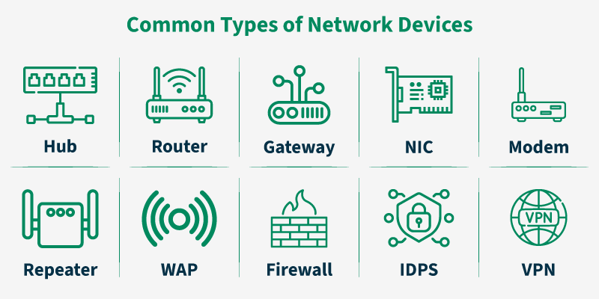
Networking Devices
Network devices are fundamental hardware components in computer networking that operate across different layers of the OSI and TCP/IP models. They facilitate data transmission, regulate traffic flow, provide interconnectivity between heterogeneous networks, and enforce security policies.
Functions of Network Devices
Enable communication by transmitting and receiving data between devices.
Allow devices to connect to networks efficiently and securely.
Improve network performance by reducing congestion and managing traffic.
Provide security by controlling access and preventing unauthorized activities.
Extend network coverage and solve signal loss or attenuation problems.

Slide 69
Hub
A hub is a multi-port repeater. A hub connects multiple wires coming from different branches, for example, the connector in star topology which connects different stations. Hubs cannot filter data, so data packets are sent to all connected devices.
In other words, the collision domain of all hosts connected through hub remains one. Hub does not have any routing table to store the data of ports and map destination addresses., the routing table is used to send/broadcast information across all the ports.
How Does a Network Hub Work?
A hub is a multiport device, which has multiple ports in a device and shares the data to multiple ports altogether. A hub acts as a dumb switch that does not know, which data needs to be forwarded where so it broadcasts or sends the data to each port.
Suppose there are five ports in a hub A, B, C, D, and E. Consider A wants to send any data frame, or let's say A is acting as a sender, so the hub will forward the data transmitted by A to B, C, D, E. Now, at the same time B also wants to send the data then data received from A and B will collide and can cause data loss. In this situation, the data gets destroyed, and the hosts send a jam signal to all the hosts informing them about the collision, and each sender needs to wait for a certain amount of time.
Note: In the hub, data is sent to all ports but each port accepts only that data whose destination address matches their MAC address.
Features of Hubs
Hubs are the hardware device that operates in the physical layer of the OSI model. It supports half-duplex transmission
It works with shared bandwidth and broadcasting. The hub can provide a high data transmission rate to different devices.
It can detect collisions in the network and send the jamming signal to each port. Hub does not support Virtual LAN(VLAN) and spanning tree protocol.
It is unable to filter the data and hence transmit or broadcast it to each port. It cannot find the best route/ shortest path to send any data, which makes it an inefficient device.

Slide 70
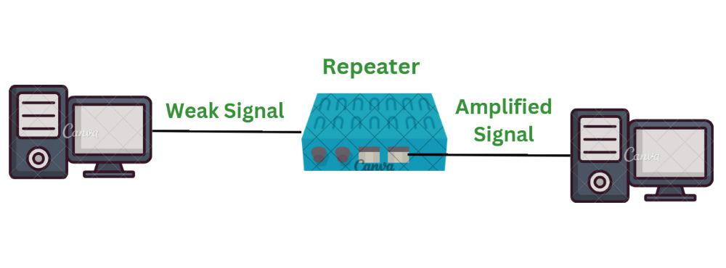
Repeater
A repeater is a network device that regenerates weakened or corrupted signals to restore them to their original form before retransmission. It operates at the physical layer (Layer 1) of the OSI model. Unlike an amplifier, which increases both signal and noise, a repeater reconstructs the original clean signal and forwards it, ensuring reliable data delivery over longer distances.
Features of Repeaters
Regenerates signals without altering the original data.
Works with both analog and digital signals (depending on the type).
Extends the range of a network beyond distance limitations.
Reduces errors and data loss caused by weak signals.
Requires power to operate.
Adds a layer of complexity in network design if used excessively.

Slide 71
Working of Repeater
Initially the source system transmits the signals. This source systems can be a mobile phone, laptop or radio.
This transmitted signal from the source system travels in air if it's wireless network or through the cable if it is wired network. As the signal goes away from the source it's strength gets weak.
The signal received to the repeater is not the actual signal sent by source system but a weak signal. Therefore repeater amplifies this weak signal to get it strengthen.
The strengthen signal is now being sent from the repeater to its destination. This signal is more stronger and can travel at longer distance. In short, it extends the network without losing the quality of signal.
Repeaters are therefore used in various wireless technologies such as Wi-Fi and wired technologies such as ethernet.
In simple terms: Source -> Weak Signal -> Repeater -> Regenerated Signal -> Destination

Slide 72
Types of Repeaters
According to the functions and features repeaters are divided into three types. They are as follow:
1. Based on Signal Type
Analog Repeater: Analog repeaters are used to amplify only the analog signals. Analog repeaters receives the analog signal, amplifies it and then regenerates it as the output. Analog repeaters were mostly used in the older network technologies where analog signal was used.
Digital Repeater: Digital repeaters are the type of repeaters that does not amplify digital signal but regenerates it directly. Digital repeaters are mostly used in the modern technologies where digital signal is being used. Digital repeaters are also capable to reconstruct a distorted signal.
2. Based on Connection Type
Wired Repeaters: Wired repeaters are used in wired Local Area Networks(LANs). Wired repeater receives the signal and repeats it. This helps to extend the network travel data without loosing it's strength and data.
Wireless Repeaters: Wireless repeaters are used in wireless Local Area Networks(LANs) and Cellular networks. A router connected in the network sends wireless signal to the repeater. Once received, repeater broadcast the signal to increase the coverage of network.
3. Based on LAN Domain Location
Local Repeaters: Local Repeaters are used in Local Area Networks where the network is very small. The distance between the devices connected in network is very small.
Remote Repeaters: Remote Repeaters are used in Local Area Networks where network is very large. The distance between the devices connected in network is more.
4. Based on Technology
Microwave Repeater: Microwave repeaters are defined as a type of repeater that are embedded between the source and destination that is transmitting station and receiving station. The use of microwave repeater depends upon the distance between two devices. In microwave repeaters high power transmitters and sensitive receivers are used.
Optical Repeater: Optical repeaters are defined as a type of repeaters that are used for the communication of fibre optic communication systems. Optical repeaters can amplify and reshape the operations before they are being transmitted. The optical repeater grabs all the signals from optical fiber cable into electronic form.
Radio Repeater: Radio repeater is a type of repeater that transmits all the received data into radio signals. Radio repeaters has two different ports namely radio receiver and radio transmitter. Radio transmitter is used to retransmit the data that is received from repeater and radio receiver collects all the incoming data in form of signals.
Telephone Repeater: Telephone repeaters are type of repeaters used for long distance networks. Amplifiers having transistors are used in telephone repeater. Telephone repeater is a bidirectional communication system. Telephone repeaters are majorly used for communication in submarines.

Slide 73
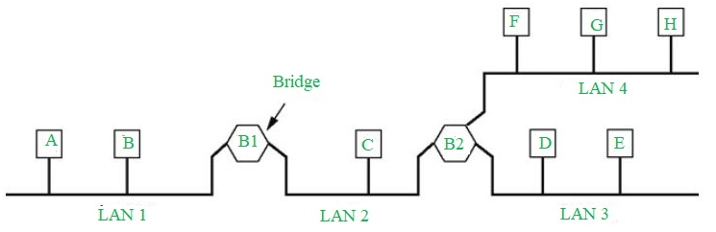
Bridge
A bridge in a computer network is a device used to connect multiple LANs together with a larger Local Area Network (LAN). The mechanism of network aggregation is known as bridging.
The bridge is a physical or hardware device but operates at the OSI model's data link layer and is also known as a layer of two switches.
The primary responsibility of a switch is to examine the incoming traffic and determine whether to filter or forward it.
Basically, a bridge in computer networks is used to divide network connections into sections, now each section has a separate bandwidth and a separate collision domain. Here bridge is used to improve network performance.

Slide 74
Types of Bridges
Transparent Bridge: Transparent bridges are invisible to other devices on the network. This bridge doesn't reconfigure the network on the addition or deletion of any station. The prime function of the transparent bridge is to block or forward the data according to the MAC address.
Source Routing Bridge: Source routing bridges were developed and designed by IBM specifically for token ring networks. The frame's entire route is embedded with the data frames by the source station to perform the routing operation so that once the frame is forwarded it must follow a specific defined path/route.
Translational Bridge: Translational bridges convert the received data from one networking system to another. Or it is used to communicate or transmit data between two different types of networking systems. Like if we are sending data from a token ring to an Ethernet cable, the translational cable will be used to connect both the networking system and transmit data.
Working of Bridges
Receiving Data: The bridge gets data packets (or frames) from both network segments A and B.
Building a Table: It creates a table of MAC addresses by looking at where the data is coming from to know which device is on which segment.
Filtering Data: If the data from network A is meant for a device also on network A, the bridge stops it from going further.
Forwarding Data: If the data from network A is meant for a device on network B, the bridge sends it to the correct place on network B.
Repeating for Both Sides: The bridge does the same thing for data coming from network B.

Slide 75
Function and Uses
Uses of Bridge in Computer Network
Bridges are used to increase the network capacity as they can integrate multiple LANs together.
On receiving a data frame, databases use the bridge to decide whether to accept or reject the data.
In the OSI model, it can be used to transmit the data to multiple nodes of the network.
Used to broadcast the data even if the MAC address or destination address is unavailable.
It forwards data packets despite faulty nodes.
The data packet can be forwarded or discarded by the bridge when the MAC address is available.
Functions of Bridges in the Network
The bridge is used to divide LANs into multiple segments.
To control the traffic in the network.
It can interconnect two LANs with a similar protocols.
It can filter the data based on destination/MAC address.

Slide 76
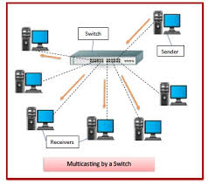
Switches
The Switch is a network device that is used to segment the networks into different subnetworks called subnets or LAN segments. It is responsible for filtering and forwarding the packets between LAN segments based on MAC address.
Switches have many ports, and when data arrives at any port, the destination address is examined first and some checks are also done and then it is processed to the devices. Different types of communication are supported here like unicast, multicast, and broadcast communication.

Slide 77
Features of Network Switches
It operates in the Data Link Layer in the OSI Model.
It performs error checking before forwarding data.
It transfers the data only to the device that has been addressed.
It operates in full duplex mode.
It allocates each LAN segment to a limited bandwidth.
It uses Unicast (one-to-one), multicast (one-to-many), and broadcast (one-to-all) transmission modes.
Packet-switching techniques are used to transfer data packets from source to destination.
Switches have a more significant number of ports.
Why Are Network Switches Valuable?
Switches are one of the most important things for transferring information between different endpoints. Some of the benefits are mentioned below.
Switches are having full-duplex communication which helps in making effective use of bandwidth.
Switches help to provide a wired connection to printers, IoT devices, wireless points, and many more devices.
IoT Devices send data through Network Switches that help in making smarter surroundings with the help of Artificial Intelligence.
Network Devices are made with the help of Switches that carry a large number of traffic in telecommunication.

Slide 78
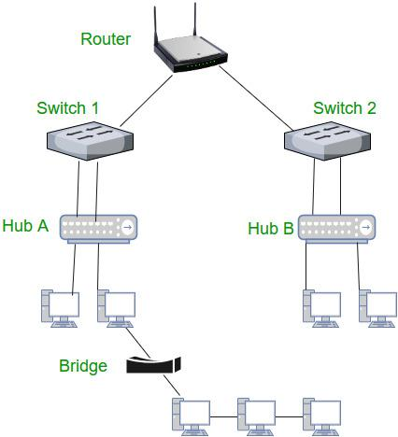
Router
A router is a networking device that forwards data packets between different computer networks. It connects multiple packet-switched networks or subnetworks, managing traffic by directing packets to their intended IP addresses. Routers allow multiple devices to share an Internet connection efficiently.
How Does a Router Work?
Routers determine the path for a packet by examining its destination IP address and consulting the routing table, which contains information on network paths. They use a set of rules to identify the most efficient route for each packet.
Static routing: Configured manually, suitable for small or stable networks.
Dynamic routing: Automatically updated based on network activity, ideal for large or changing networks.

Slide 79
Functions of a Router
Forwarding: Receives packets, examines headers, and forwards them to the correct output port.
Routing: Determines the optimal path for packets using routing tables and algorithms.
Network Address Translation (NAT): Translates private IPs to a public IP for Internet access.
Security: Supports firewalls and other security measures.
VPN Connectivity: Provides secure remote access to networks.
Bandwidth Management: Controls data flow to prevent congestion.
Monitoring & Diagnostics: Tracks traffic and helps troubleshoot network issues.

Slide 80
Gateway
A gateway is a network connectivity device that connects two different configuration networks. Gateways are also known as protocol converters, because they play an important role in converting protocols supported by traffic on different networks.
As a result, it allows smooth communication between two networks. It works as the entry-exit point for a network because all traffic that passes across the networks must pass through the gateway. A gateway monitors and controls all the incoming and outgoing network traffic.
Features of Gateways
A gateway is situated at a network edge and manages all data that enters or exits the network.
A gateway is distinct from other network devices in that it can operate at any layer of the OSI model.
Gateways made the transmission more feasible as it queued up all the data and divided it into small packets of data rather than sending it bulk.
Gateways provide security within the network.
How Gateways Work?
The gateway receives data from devices within the network.
After receiving data the gateway intercept and analyze data packets, which include analyzing packet header, payload etc.
Based on the analysis of the data packets, the gateway calculate an appropriate destination address of data packet. It then routes the data packets to their destination address.
In some cases, the gateway might also want to transform the format of the obtained data to ensure compatibility at the receiver.
Once the data packets have been analyzed, routed, and converted, then the gateway sends the last packets to their respective destinations address inside the network.

